Slide 1
LTL in MCC Definition of Semantics
Karsten Wolf

Slide 2
One-Step Reachability Relation
Assume for the whole document that N is a fixed (PT or CP) net.
Let m, m' be markings of N.
Define m →m' if
(PT net:) there is a transition t such that firing t in m leads to m'
(CP net:) there is a transition t and a binding d of t such that firing (t,d) in m leads to m'
m is called deadlock if there is no m' with m → m'

Slide 3
Trace
A trace is an infinite sequence of markings connected by the one-step firing relation. The sequence may contain a deadlock marking which is then repeated forever.
Formally:
Infinite sequence of markings (m₁ m₂ m₃ ....) is a trace if, for all i ≥ 1:
m_{i} →m_{i+1}, or
m_{i} is a deadlock and m_{i+1}=m_{i}

Slide 4
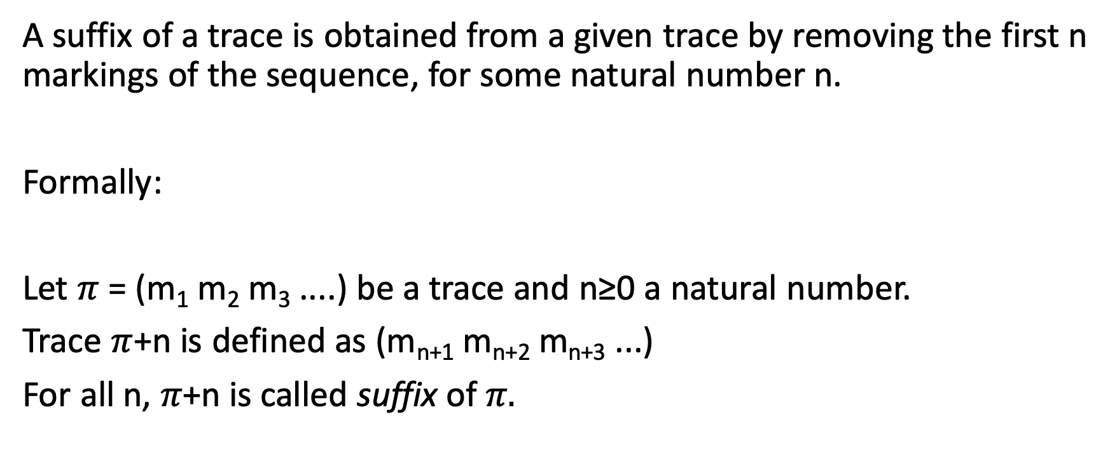
Suffix
A suffix of a trace is obtained from a given trace by removing the first n markings of the sequence, for some natural number n.
Formally:
Let $π$ = (m₁ m₂ m₃ ....) be a trace and n≥0 a natural number.
Trace $π$+n is defined as (m_{n+1} m_{n+2} m_{n+3} ...)
$\text{For} \text{all} \text{n}\text{, }π\text{+}\text{n}$ is called suffix of $π.$

Slide 5
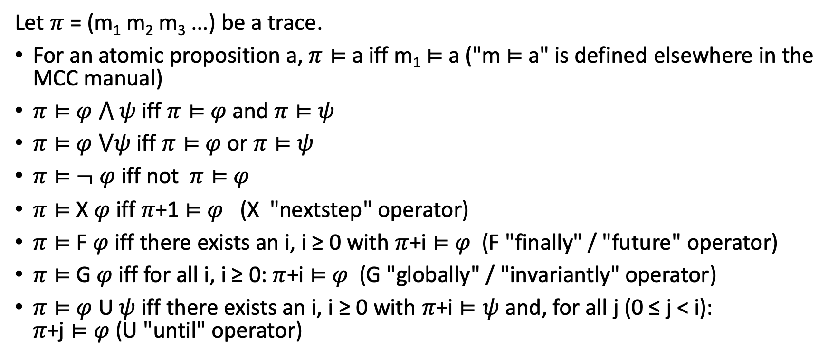
Satisfaction of LTL formulas in traces
Let $π$ = (m₁ m₂ m₃ ...) be a trace.
For an atomic proposition a, $π⊨$a iff m₁ $⊨$a ("m $⊨$a" is defined elsewhere in the MCC manual)
$π⊨$ $φ$ $⋀$ $ψ$ iff $π⊨$ $φ$ and $π⊨$ $ψ$
$π⊨$ $φ$ $⋁ψ$ iff $π⊨$ $φ$ or $π⊨$ $ψ$
$π⊨$ $¬ φ$ iff not $π⊨$ $φ$
$π⊨$ X $φ$ iff $π$+1 $⊨$ $φ$ (X "nextstep" operator)
$π⊨$ F $φ$ iff there exists an i, i ≥ 0 with $π$+i $⊨$ $φ$ (F "finally" / "future" operator)
$π⊨$ G $φ$ iff for all i, i ≥ 0: $π$+i $⊨$ $φ$ (G "globally" / "invariantly" operator)
$π⊨$ $φ$ U $ψ$ iff there exists an i, i ≥ 0 with $π$+i $⊨ψ$ and, for all j (0 ≤ j < i): $π$+j $⊨φ$(U "until" operator)

Slide 6
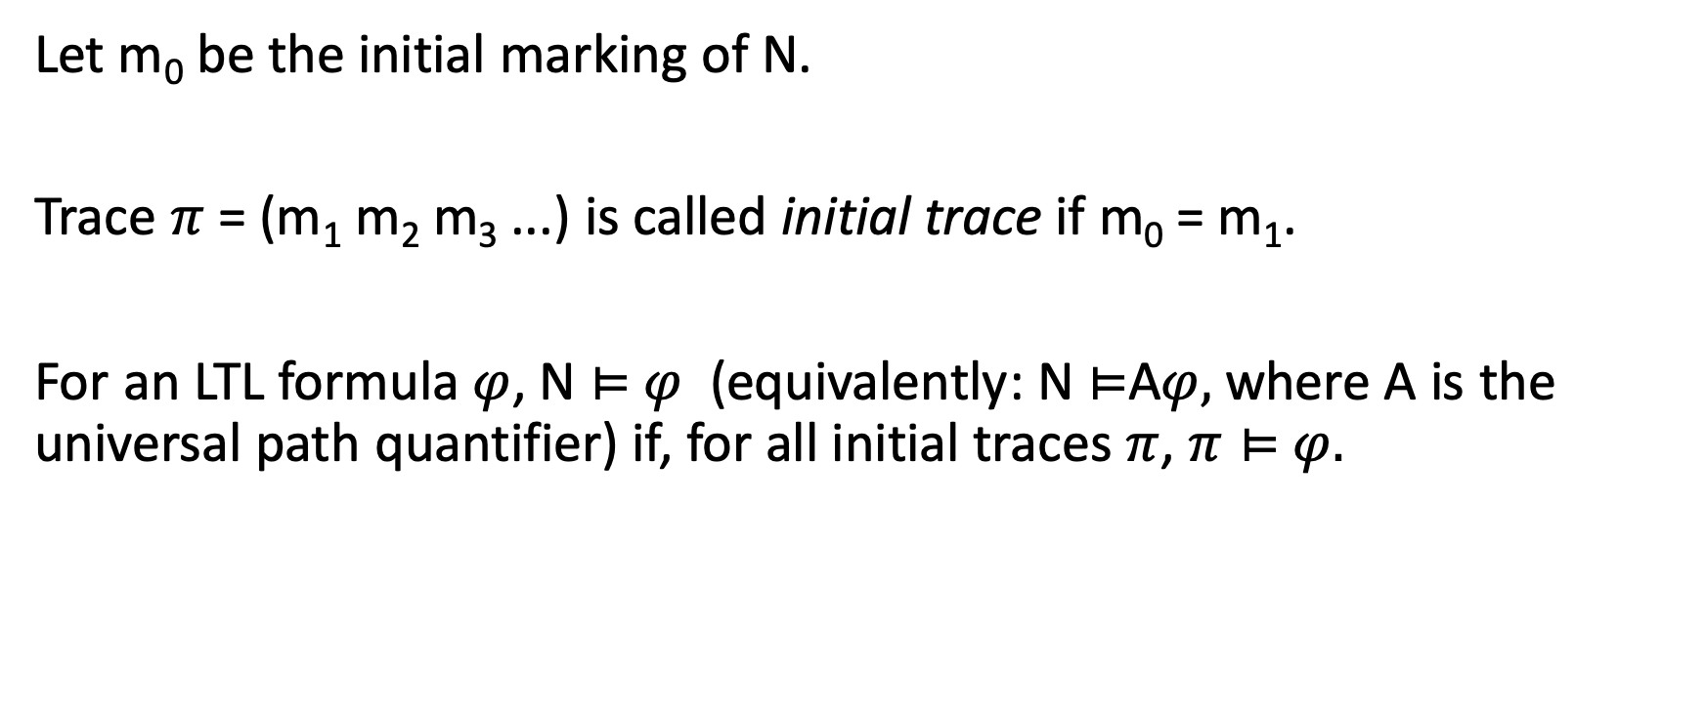
Satisfaction of LTL Formula in Petri Net
Let m₀ be the initial marking of N.
Trace $π$ = (m₁ m₂ m₃ ...) is called initial trace if m₀ = m₁.
For an LTL formula $φ$, N $⊨$ $φ$ (equivalently: N $⊨$A$φ,$where A is the universal path quantifier) if, for all initial traces $π$, $π⊨$ $φ.$

Slide 7

LTL category in MCC
Problem description:
Given
A (PT or CP) net N and
an LTL formula $φ$,
decide whether N $⊨$ $φ$!

Slide 8
Remarks
Our definitions implicitly transform the reachability graph of N into a Kripke structure. A Kripke structure is a transition system where every state has at least one successor state. The transformation consists of adding, for each deadlock marking m, m as its own successor (self-loop). We have implemented this transformation in our definition of "trace". For Kripke structures, the definition of LTL semantics is undisputed, to our best knowledge.

